Slide 1
artificial intelligence in digital marketing and the ethical concerns

Slide 2
AI and Predictive Analytics
Tarun Tatakuntala
B1231849

Slide 3
MAIN goals of marketing
Marketing products to reach the customers
Customer Experience
Sales of the product
Targeting correct customers

Slide 4
AI applications in MARKETING
Recommender systems
Predictive Analytics
Conversational Chatbots
Computer vision

Slide 5
PREDICTIVE ANALYTICS in marketing
What is Predictive Analytics?
Predictive analytics uses statistics and modeling techniques to determine future performance. It looks at current and historical data patterns to determine if those patterns are likely to emerge again.
Industries and disciplines, such as insurance and marketing, use predictive techniques to make important decisions.
Predictive models help make weather forecasts, develop video games, translate voice-to-text messages, customer service decisions, and develop investment portfolios.

Slide 6
HOW Predictive Analytics USED IN MARKETING?
1. Targeting and Segmenting the Audience
2. Distributing the Targeted Content
3. Predicting Customer Behaviour
4. Predictive Lead Scoring
5. Predicting Customer Lifetime Value
6. Acquiring New Customers
7. Determining Better Product or Service Fit
8. Upselling and Cross-Selling to Current Customers
9. Reducing the Customer Churn Rate
10. Optimizing Future Marketing Campaigns

Slide 7
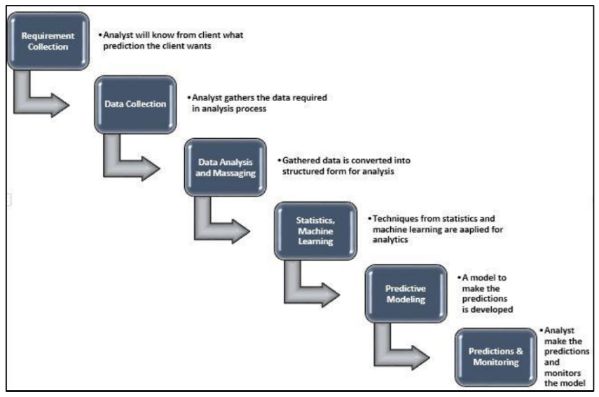
HOW DOES Predictive Analytics PROCESS WORKS?

Slide 8
ETHICAL ISSUES of Predictive analytics
If biased data is provided, predictions are also biased.
Inconsistency in data collection leads to misleading information.
Incomplete data

Slide 9
CASE STUDY Amazon hiring algorithm
In 2014, Amazon developed an algorithm which searches through thousands of job applications(CVs) and predicts the right candidates for the role.
But the algorithm started selecting only male applicants and ignored all the female applicants.
WHY?
While developing the algorithm, the data took from hiring trends based on early 1990 – 2000.
During this period, male employees count is much greater than female employees. Due to this the algorithm started predicting only male applicants.

Slide 10
HOW CAN WE AVOID THIS PROBLEM? DATA ANALYSIS METHOD
If data is biased, there are two ways to avoid the problem
Upsampling/Oversampling
Downsampling/Undersampling

Slide 11
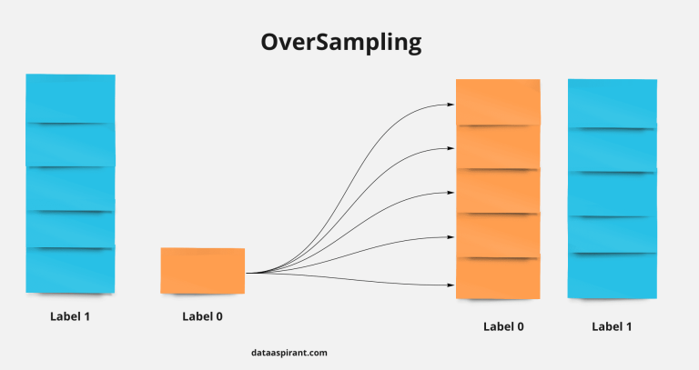
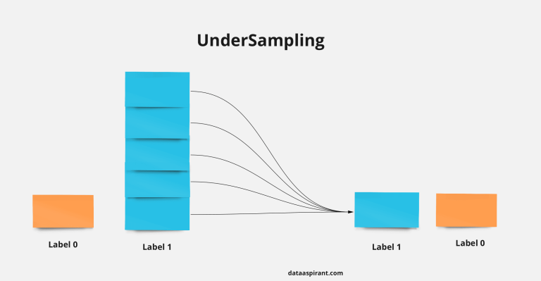
Upsampling/Oversampling:
In oversampling, we increase the number of samples in minority class to match up to the number of samples of the majority class.
Downsampling/Undersampling:
In undersampling, we decrease the number of samples in the majority class to match the number of samples of the minority class.

Slide 12
conclusion
There are many benefits associated with AI when it comes to marketing, including improved product and content recommendations, better social engagement, better customer service, and improved search.
However, marketers should be sure to use AI wisely in order to avoid losing of consumer trust. This includes transparency when it comes to data collection and use, as well as implementing responsible marketing tactics.
Although the risks associated with it, artificial intelligence is here to stay, and it is sure to continue to shape marketing in the future.

Slide 13
references
Charles Elkan, 2013, “Predictive analytics and data mining”, University of California, San Diego.
Eric Siegel, 2016, “Predictive Analytics”, John Willey and Sons Ltd.
Charles Nyce, 2007, “Predictive Analytics White Paper”, American Institute of CPCU/IIA.

